Slide 1
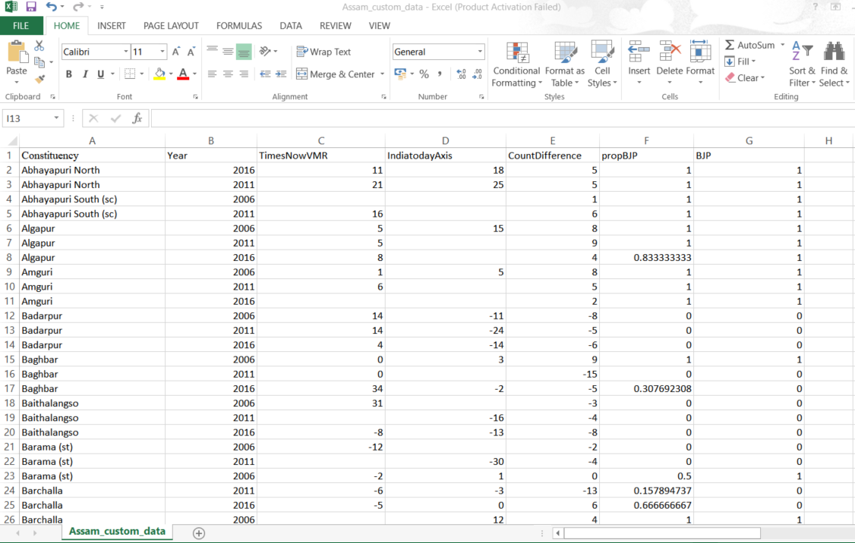
Choosing appropriate predictors

Slide 2
ASSAM_2021_POLL_PREDICTIONS

Slide 3
The making of the CSV file
Assam has 126 constituencies for the state legislative assembly.which are given in the first column.
There are 2 prominent political alliances in Assam presently –BJP(In alliance with AGP and UPPL) and AIUDF(in alliance with Congress).
We have enlisted 2 prominent political survey agencies backed my media houses-TimesNowVMR and IndiaTodayAxis.We have inputed dummy data for observation.
Data for all the results in the 126 constituencies is collected over 3 election years namely-2016,2001,2006 so in total there are 126*3=378 observations available.

Slide 4
The making of the CSV File
The first column represents the 126 constituencies.
The second column represents the three election years-2006,2011,2016 for which the data is collected.
The third and fouth column consists of data collected by survey agencies-TimesNowVMR and IndiatodayAxis.The values are written as % of votes secured by BJP- % of votes secured by AIUDF.For eg a value of -4 suggests that AIUDF has got 4% more votes than BJP in that constituency.
The fifth column is CountDifference.It stores difference of the Polls for which BJP is the winner- Polls for which AIUDF is the winner
The sixth column is probBJP.It stores the proportion of the polls for which BJP
is the winner divided by the total number of polls .The seventh column is BJP
A value of 1 in the BJP column suggests that BJP alliance won that seat in that election year.A value of 0 suggests that AIUDF alliance won that seat

Slide 5
The making of the CSV File
In our data the columns TimesNowVMR,IndiaTodayAxis,CountDifference and propBJP are the independent variables and the BJP column is the
Response variable.

Slide 6
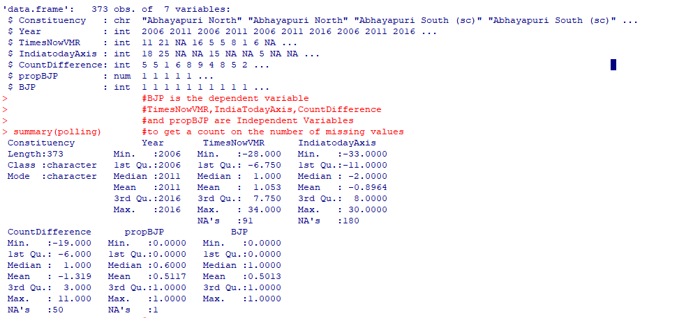
Code creation-The structure of the dataset

Slide 7
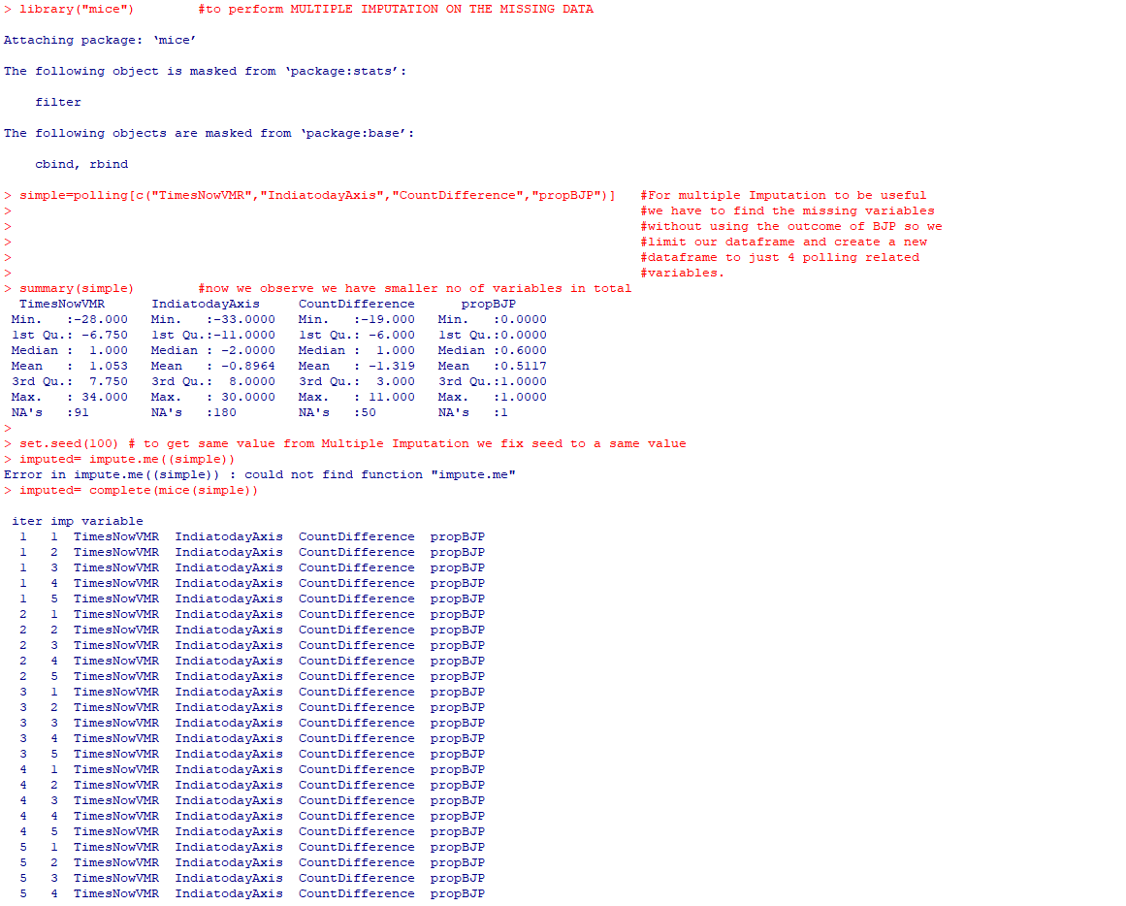
Performing Multiple Imputation(Replacing the NA Values)

Slide 8
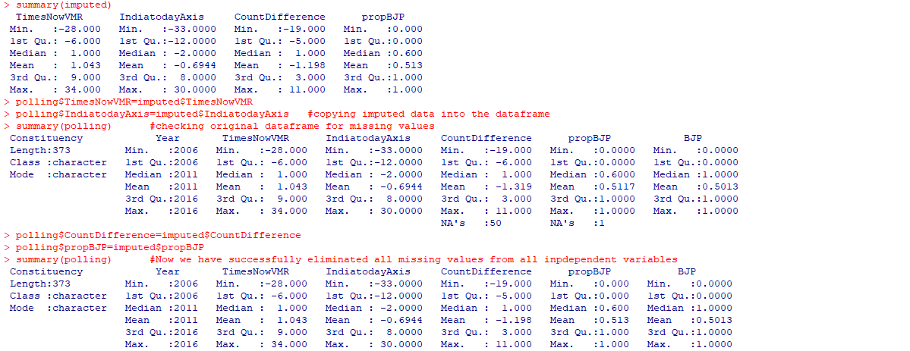
After multiple Imputation NA values are removed

Slide 9
Splitting of the dataset -Training and testing

Slide 10
Creating the baseline model

Slide 11
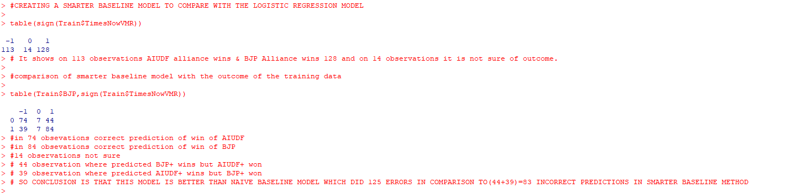
Creating a smarter baseline model

Slide 12
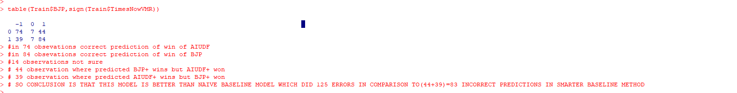
comparison of smarter baseline model with the outcome of the training data

Slide 13
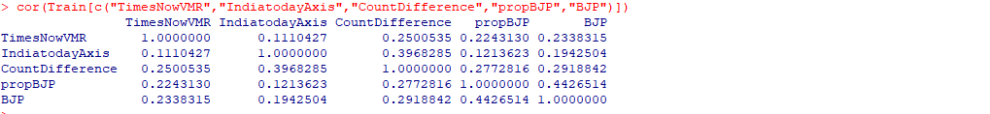
CREATING A LOGISTIC REGRESSION BASED MODEL & understanding Multicollinearity

Slide 14
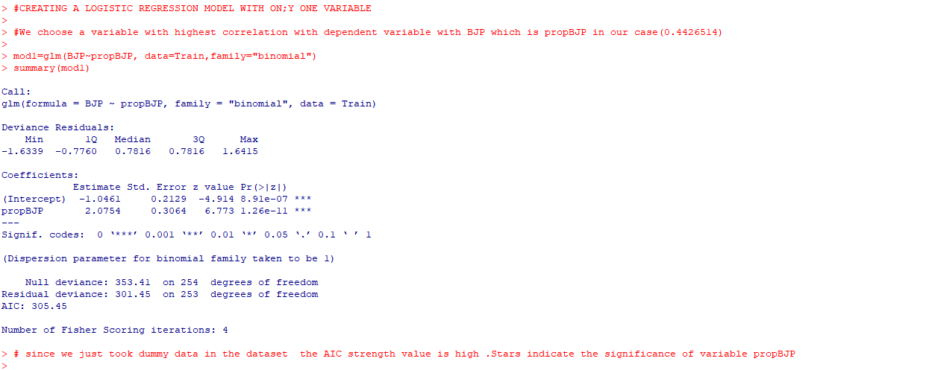
#CREATING A LOGISTIC REGRESSION MODEL WITH ONLY ONE VARIABLE-mod1

Slide 15
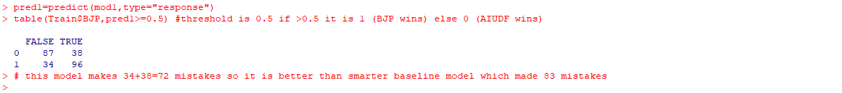
Predictions on mod1 model

Slide 16
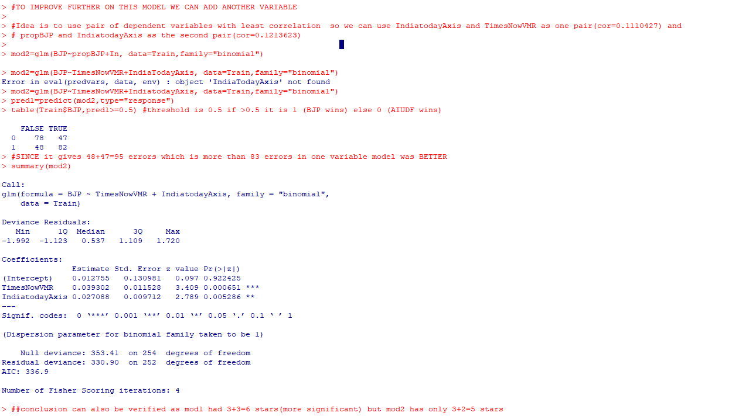
With the intention TO IMPROVE FURTHER ON THIS MODEL WE CAN ADD ANOTHER VARIABLE

Slide 17
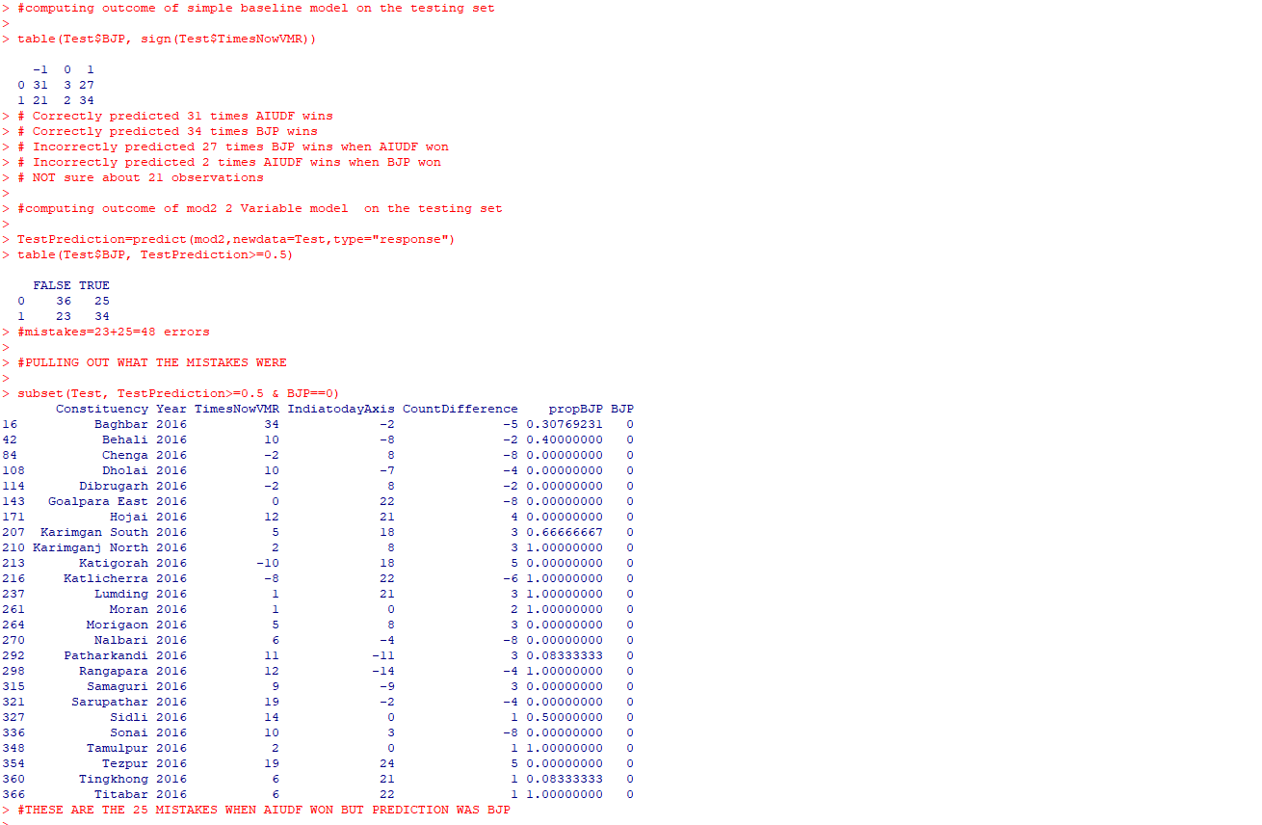
Outcome of smart baseline model and 2 variable model on testing set

Slide 18
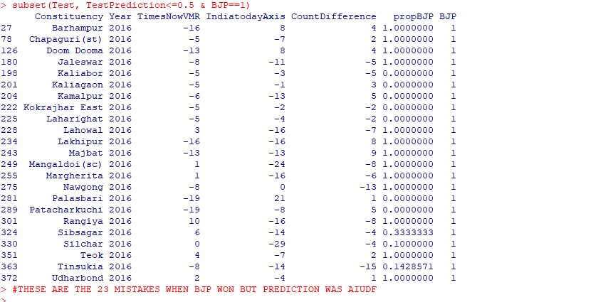
Outcome of 2 variable model on testing set

Slide 19
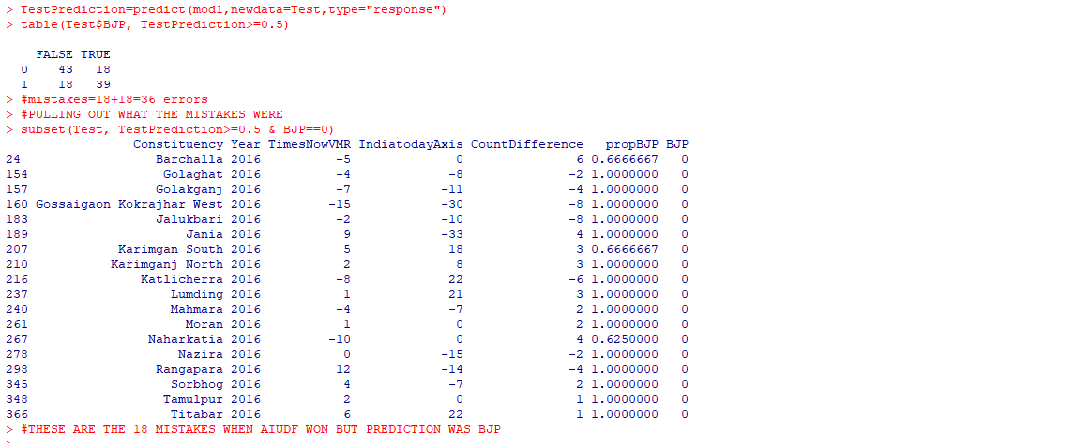
TESTING THE MODEL mod1 WHICH HAD LEAST TRAINING ERRORS OF ALL MODELS

Slide 20
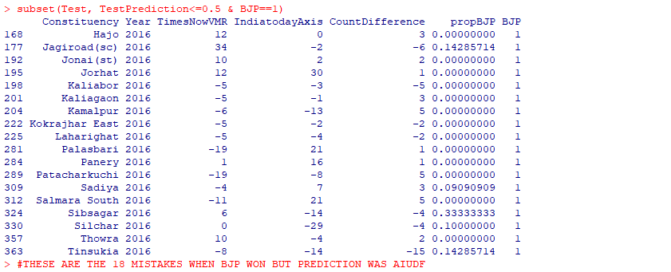
TESTING THE MODEL mod1 WHICH HAD LEAST TRAINING ERRORS OF ALL MODELS

Slide 21

The conclusion-Which is the best model?

Slide 22
References
https://eci.gov.in/assembly-election/ae-2021-assam/
https://en.wikipedia.org/wiki/2021_Assam_Legislative_Assembly_election

